Slide 1

DriverPass System Analysis
Nicholas Ciesla
Notes:
[No speaker notes required for this slide.]

Slide 2

System Requirements
Nonfunctional Requirements:
The system should run on any modern web browser, mobile or desktop.
Any server-side updates will be handled by the cloud service.
Functional Requirements:
The system shall assign a session type based on the user’s account type and selected learning package.
The system shall allow the admin and owner to modify all accounts.
Notes:
While these are not all the requirements that we have determined for the DriverPass system. We feel these are some of the more important requirements that we discussed in our meeting. If you want to comb through all our requirements, we can go over the Business Requirements Document after the presentation. Firstly, the Nonfunctional Requirements…
Nonfunctional requirements generally focus on the performance of the system rather than what the system will do. The first Nonfunctional Requirement listed states that the system should run on any web browser, including mobile. This allows your customers, or employees, to access the DriverPass application from virtually any modern device with an internet connection. Making your site easy to reach in this way allows more people to view your site than would if they had to download an app. The second Nonfunctional Requirement states that any server-side updates will be handled by the cloud service. That means that any time a large-scale software update happens, you will not need to worry about maintaining your system, whichever cloud service you decide to use going forward will handle all of this for you. This makes it much easier to focus on the business and learning side of things.
Now, on to Functional Requirements. Functional Requirements govern what users should be able to do with the application. The first Functional Requirement states that the system shall assign a session type based on the user’s account type and selected learning package. This means that each user will have a tailored experience based on which learning package they chose at sign up. Perhaps more importantly, this also means that when you, your secretary, or your drivers log in; they will have tools available to them that the customer will not. These include things that we have discussed like exporting data with excel, creating driving lessons for customers, and updating passwords for users. The Second Functional Requirement listed states that The system shall allow the admin and owner to modify all accounts. This will allow you to help users that have forgotten their password or input a piece of information like address or credit card incorrectly. This will help make the site experience better for users that may not be familiar with using computers.

Slide 3
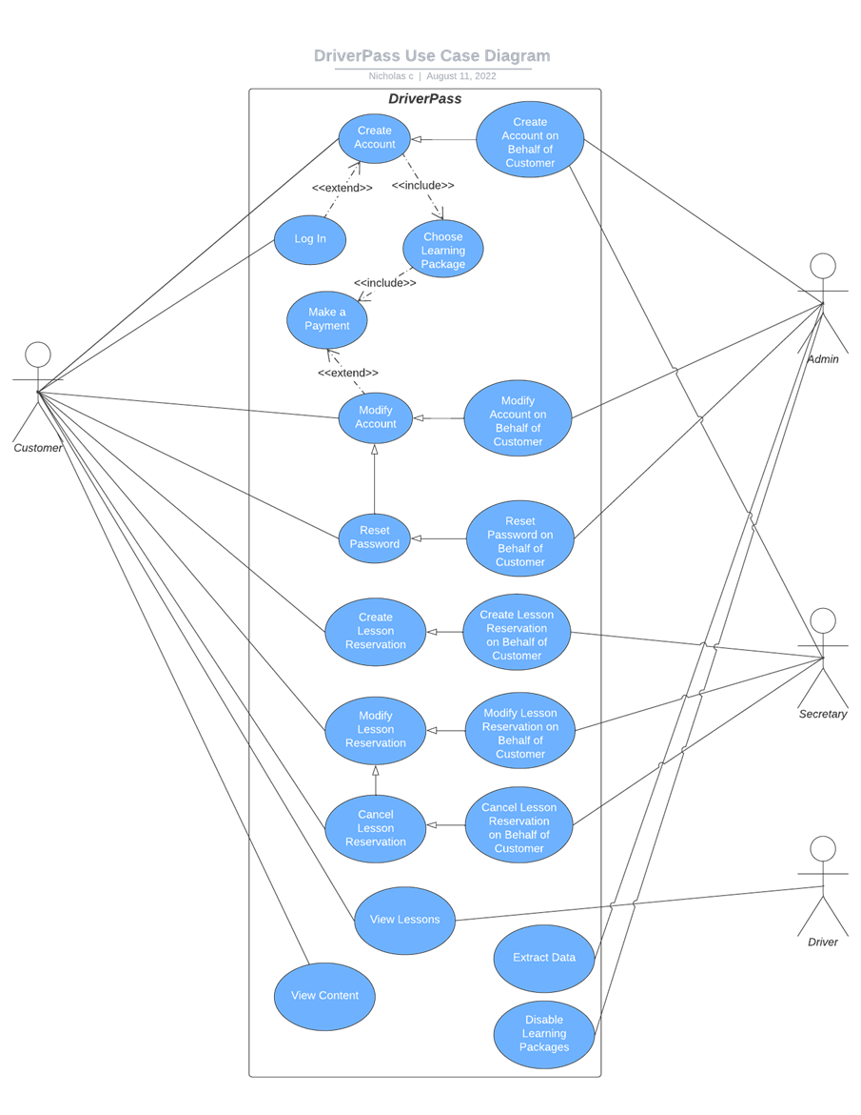
Use Case Diagram
Notes:
This Diagram is called A Use Case Diagram. This diagram represents who will use the DriverPass system and what they will be able to do. Each group of people is represented by a stick figure, and the blue bubbles are the actions that they will be able to take. This does not necessarily cover everything that everyone will be able to do, but we tried to capture the most important things that were requested. Arguably the most important stick figure on this diagram is the one that represents the Customer. The customer will be able to create an account, log in, choose a learning package, make a payment, modify their account, reset their password, create/modify/cancel a lesson reservation, view their lessons, and view learning content. The next stick figure represents the Admin. For the sake of simplicity, we have combined the Admin and Owner into one person. The admin will be able to create/modify an account on behalf of a customer, reset a customer’s password, create/modify/cancel a lesson reservation on behalf of a customer, extract data, and disable learning packages. We believe that this covers all the requested functionality for the Owner and the Admin. However, as discussed, we can investigate modifying learning packages on the fly in a future update. The Secretary can be thought of as a simplified Admin. The Secretary will be able to create (not modify or reset the password of) user accounts and create/modify/cancel a lesson reservation on behalf of a customer. The Driver stick figure only has one possible action. This action is viewing lessons. We felt that this was all that was requested. If you feel that the driver should be able to do more, please let us know at the end of the presentation.

Slide 4
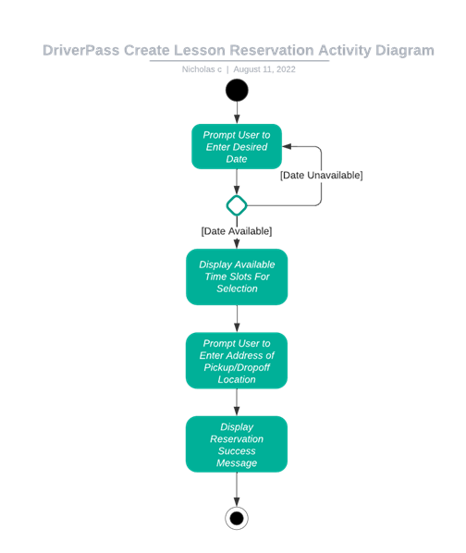
Activity Diagram
Notes:
This diagram is called an Activity Diagram. We have chosen to outline how lesson reservation will be handled within the DriverPass system. This flowchart walks through each step the system and user will take to successfully create a reservation. First, the system will prompt a user to enter a date that works for them. Next, the system will check if that date has any available time slots. If the system has no available slots, it will ask for a new date. After an open date is found, it will show the available time slots for the user to select. Once that is selected, it asks the user to enter a pickup/drop-off location. After this, the reservation has successfully been created and a success message is displayed. This makes creating a reservation for the user rather simple. If you have any concerns with how this is being handled, please let us know at the end of the presentation.

Slide 5
Security
Users should log in to the system with their email and password.
A Certificate Authority should be used to verify the identity of Driver Pass to the client.
Any communications containing sensitive information should be encrypted.
The user should get a maximum chance of 10 login attempts before they need to reset their password via emailed link or over the phone.
Sensitive user information such as passwords and cc numbers should be stored as hash values in the database.
Notes:
We considered security in the creation of every part of this design. Firstly, just like most traditional websites, the user will need to log in. This allows us to differentiate between different users with different reasons to be using the system and keeps customers away from the admin tools. Next, we should be using a certificate authority to ensure that our users are not tricked by someone trying to impersonate us. A certificate authority is essentially a third part that confirms with the customer’s web browser that we are who we say we are. This ties into the third point, that all communications containing sensitive information should be encrypted. This means that we should do everything we can to hide things like credit card numbers or addresses using secret codes. Users should also only get 10 login attempts before they are required to reset their password to ensure that someone trying to break into their account has a limited amount of tries. This helps to keep user information safe from malicious entities. Lastly, tying into the point about encryption, we should store all sensitive information as “hash values”. This means that things like credit card numbers or addresses should be run through a reversable set of math equations, this way they will appear as scrambled nonsense to anyone who views them in the database. This prevents hackers or possibly malicious employees from stealing any useful information on users. I have tried my best to explain the more technical concepts, but if you have any questions about this slide, please feel free to ask them now.

Slide 6
System Limitations
DriverPass will not be able to add new learning packages without changing code.
DriverPass will not be able to add learning modules without changing code.
The system will not be able to be accessed without an internet connection.
Notes:
The primary limitation with this design is that all possible users will require a modern computer and an internet connection. However, that is not much of a limitation these days as most people at least have a smartphone in their pocket. However, the limitations stating that the content of the site will not be easily changeable will likely be your biggest concern. Creating a system that will allow DriverPass to manage their own content will take time and should be handled in a sperate release. This way, you can get your online business started sooner and we can work on that while you are already running.
Now that we have covered these things, I would love to hear your feedback. Let's start with the things you like and then move on to the things you feel need improvement.

